Slide 1
Financing Small Multifamily Rental Housing
Presentation to the
Government Accountability Office
June 8, 2015

Slide 2
Rental Housing Stock 2013
Total Stock 40.4 Million
1-4 unit buildings 22.1 (55%)
Multifamily (5+ units) 16.9 (42%)
Manufactured housing 1.4 (3%)
Source: Fannie Mae based on American Housing Survey
Buildings with 5-49 units contain >2/3 of multifamily rentals and >1/3 of all rentals
Source: HUD

Slide 3
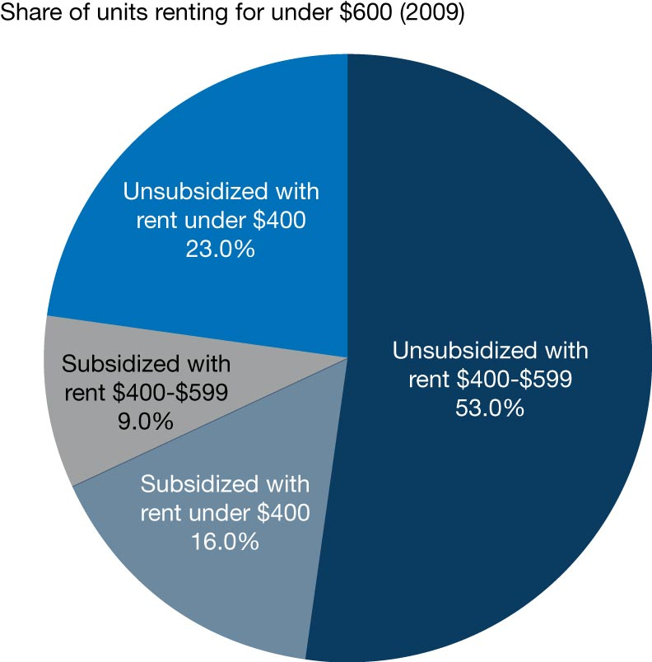
Most Affordable Rentals are Unsubsidized
Source: Harvard Joint Center for Housing Studies

Slide 4
Characteristics by Property Size (2012)
Property size (units): 5-24 25-49 50+
Median rent $541 $628 $716
Owned by Individuals 53% 23% 7%
With mortgage 59% 78% 87%
Sources: HUD 2012 Rental Housing Finance Survey; Harvard Joint Center for Housing Studies

Slide 5
Small MF Lending Challenges
Harder to support fixed lending and servicing costs
Harder to underwrite small-scale owners than large, professional real estate companies
More limited capital reserves
Less sophisticated property management, asset management, and information systems
Smaller portfolios limit risk diversification
Harder to sell small loans on secondary market
Holding loans in portfolio requires more capital
Harder to retain long-term, fixed-rate loans in lender’s portfolio (asset/liability mismatch)

Slide 6
MF Lender Industry Bifurcation (2011)
Lenders: Market Share:
$ Volume # (%) Volume Loans Avg. Loan
<$1M 2,561 (96.5%) 12% 43% $1.0M
>$1M 92 (3.5%) 88% 57% $5.5M_
>$2.5B 10 (0.4%) 45% 27% $5.9M
$1B-$2.5B 12 (0.5%) 19% 7% $10.1M
$500M-$1B 19 (0.7%) 12% 11% $3.9M
$1M-$500M 51 (1.9%) 11% 12% $3.9M
Sources: Mortgage Bankers Association; Harvard Joint Center for Housing Studies

Slide 7
MF Lending Change by Mortgage Size 2006-2011
Loan amount #loans Secondary GSE Share
Market of Sec Mkt
>$500K -47% -92% -89%
$500K-$1M -38% -92% -74%
$1M-$2.5M -16% -74% -39%
$2.5M-$25M -4% -23% +38%
>$25M +18% +41% +142%
Source: Harvard Joint Center for Housing Studies

Slide 8
MF Originations by Channel
Year Volume Fan/Fred FHA Private
2005 $133B 18% 2% 79%
2007 $147B 23% 1% 76%
2009 $53B 59% 6% 35%
2011 $110B 40% 11% 50%
2013 $170B 31% 10% 58%

Slide 9
MF Loans in Upper-Income Census Tracts Tend To Be Larger (2011)
Tract Income: Low Mod-Mid Upper
Loan size:
<$1M 60% 60% 45%
$1M-$2.5M 23% 22% 27%
>$2.5M 17% 18% 28%
Source: Harvard Joint Center for Housing Studies

Slide 10
Expanding Liquidity for Small MF Loans
FHFA proposed small MF property loan purchase goals for Fannie/Freddie
FHFA excluded small MF property loans from $30B annual MF loan purchase cap
HUD/FHA to open Section 542 Risk Sharing platform for small MF loans up to $3M-$5M

Slide 11
Role of Small Multifamily Properties in Rental Market
 | U.S. | Cook County | Chicago
1 Unit | 33.5% | 13.8% | 9.6%
2 to 4 | 18.7% | 32.7% | 38.6%
5 to 49 | 31.4% | 33.9% | 29.6%
50+ | 11.6% | 18.9% | 21.8%
Other | 4.7% | 0.6% | 0.4%
Source: 2010 ACS, Data Element B25032 – Tenure by Units in Structure

Slide 12
Cook County Rental Housing Snapshot
Cook County Renter Households | 831,000 (43%)
Median Income Renter Households | $33,000
Renter Households with < $33,000 Income | >400,000
Median Rent | $938
Income Level to “Afford” Median Rent | $37,250
Rental Households with Income <$35,000 – Percent Cost-Burdened | >80%

Slide 13
Shortage of Affordable Rental Units – Cook County
Year | Households in Need of Affordable Rental Housing | Supply of Available Units | Gap
2005 | 461,000 | 296,000 | 165,000
2012 | 523,000 | 347,000 | 176,000
2020 |  |  | 224,000
Source: Institute for Housing Studies, The State of Rental Housing in Cook County, 2011, 2013.

Slide 15
Characteristics of Affordable Rental Housing in the Chicago area
Privately owned and financed
In buildings with less than 50 units
In older buildings (80-100yrs old)
Located in low and moderate income communities
Transit oriented, walkable
Have suffered most loss in value, foreclosure, abandonment

Slide 16
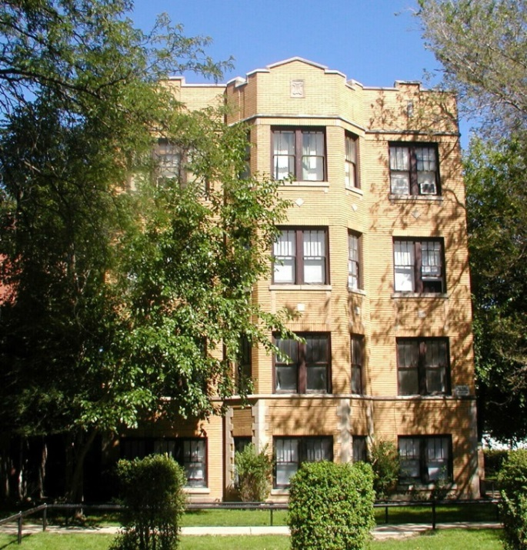
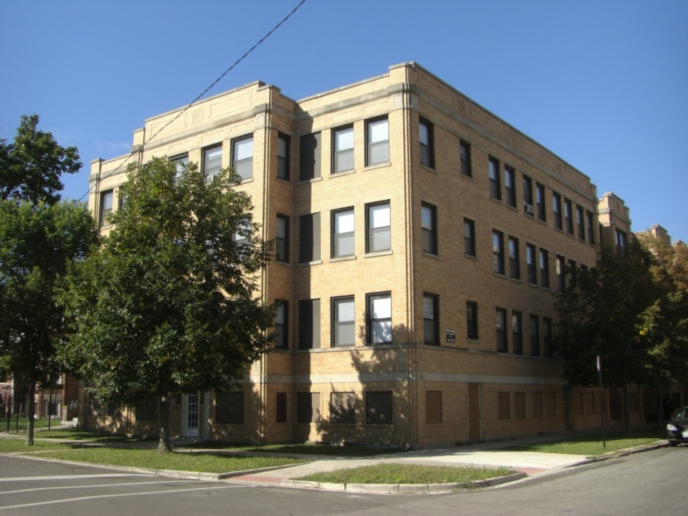
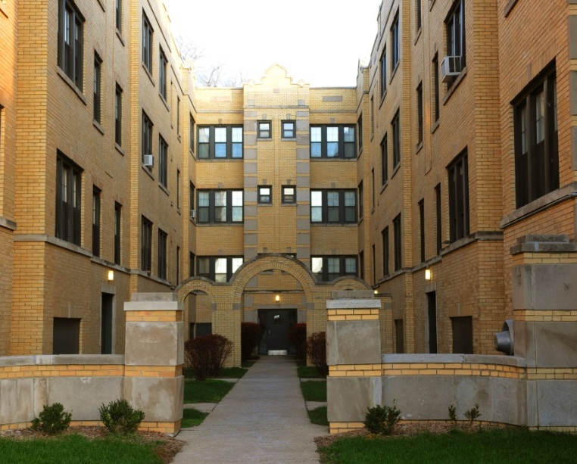
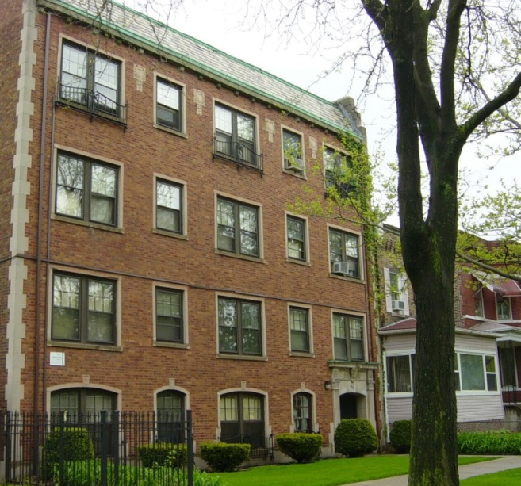
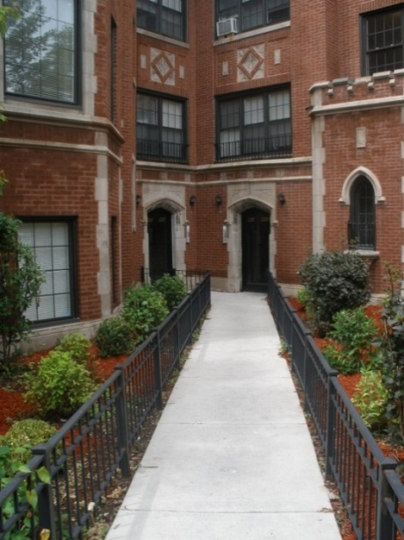

Slide 17
Snapshot of Two Communities
 | North Center | Greater Grand Crossing
Total Population | 31,867 | 32,602
Change (2000-2010) | -0.1% | -15.6%
Residents in Poverty | 7.2% | 31.4%
Median HH Income | $83,077 | $30,296
Change (2000-2010) | 25.6% | -15.9%
Unemployment Rate | 4.5% | 18.9%
Net Change in Housing Units (2000-2010) | 402 | -600
Median Gross Rent | $1,131 | $777
Foreclosures 2011-2012 | 201 | 625
Home Sales 2012-2013 | 2,010 | N/A
Source: Chicago Rehab Network Affordable Housing Fact Sheets, 2000 and 2010 Census

Slide 18
Owners of 5-49 Unit Buildings
Own 5 -1,000+ units
Median: 4 buildings/28 units
65% ownership/management full time job
68% >10 years
39% minority, 24% women-owned businesses
Employees – most: 0-2, average: 4
Small Business Owners!

Slide 19
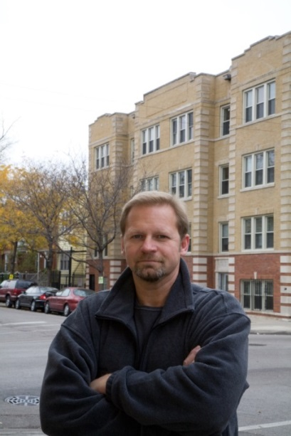

Slide 20
Efficiency of Preservation
Building new rental housing can cost $300,000-$400,000 per unit.
The cost of rehab depends on the size and condition of the building, but many investors complete rehab projects for $40,000 - $50,000 per unit.

Slide 21
About Community Investment Corporation
Consortium lender, Community Development Financial Institution (CDFI)
$1.2 billion in financing to rehab buildings with 55,000 units since 1984
37 bank investors provide $200 million for the next 5 years
www.cicchicago.com

